Slide 1
Resource Overview
Slide 2: Directions and example
Slide 3: Create your own example and directions!
Slides 4-5: Editable components - students can write their poem and move the text boxes around as they wish.
Slides 6-9: Non-editable slides - students can use the existing structure to create their poetic texting conversation
Slides 10-12: Blank templates - students can add their own text message components and design the screen anyway they’d like
Slides 13: Starting image bank (encourage students to look for a photo that inspires them! - Pixabay is a great place to start.)
You may want to identify a specific learning goal for students. For example, do you want them to…
Incorporate vocabulary
Use a specific type of figurative language
Use structure (rhythm and rhyme)
Incorporate a certain kind of punctuation in their writing

Slide 3
Insert - Image
Teachers, you can use this page to create your own example or to write your own assignment directions for students.
type
type
type
type

Slide 4
Insert - Image
Insert - Image
Insert - Image
type
type
type
type
type
type
type
type
type
type
type
type

Slide 5
Insert - Image
Insert - Image
Insert - Image
type
type
type
type
type
type
type
type
type
type
type
type

Slide 6
Insert - Image
Insert - Image
Insert - Image
type
type
type
type
type
type
type
type
type
type
type
type
type
type
type

Slide 7
type
type
Insert - Image
type
type
type
type
Insert - Image
type
Insert - Image
type
type
type
type
type
type
type

Slide 8
Insert - Image
Insert - Image
Insert - Image
type
type
type
type
type
type
type
type
type
type
type
type
type
type
type
type
type
type

Slide 9
type
type
Insert - Image
type
type
type
type
Insert - Image(s)
Insert - Image
type
type
type
type
type
type
type
type
type

Slide 10
type
type
type
type
type
type
type
type
type
type
type
type
type
type
type

Slide 13
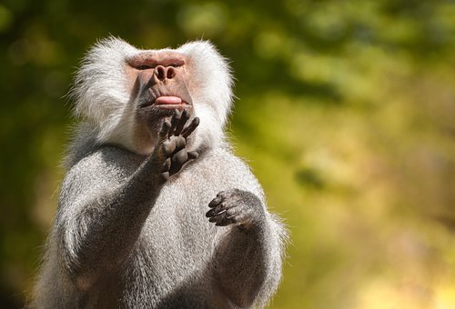
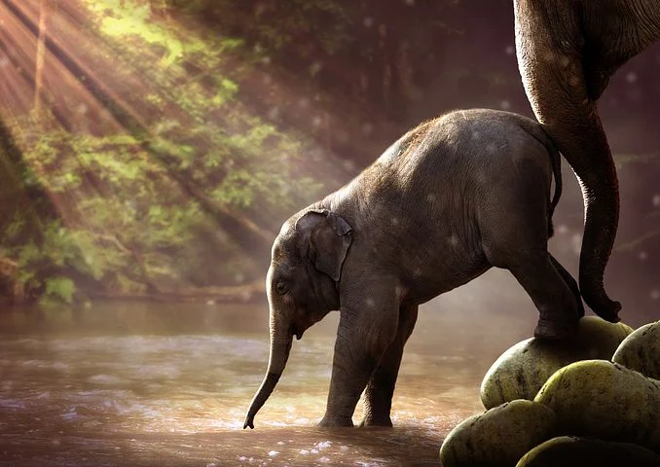
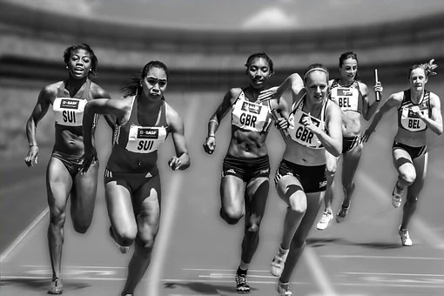
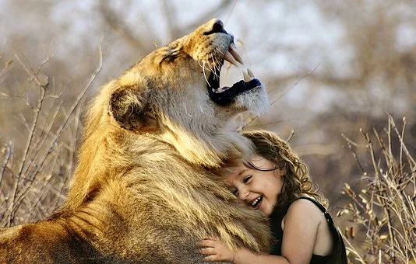
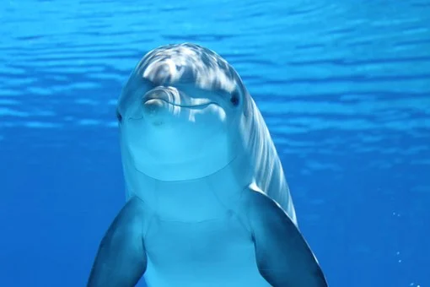
Notes:
Photos in bank from Pixabay

