Slide 1
The Purpose of Illustrations in Children’s Books
The Way Back Home
By Oliver Jeffers

Slide 2
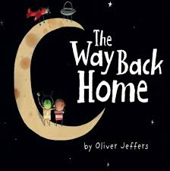
Slide 1
Word count: maximum number of words is 1000
Illustrations play a key role in telling the story
Notes:
Children’s books should have a catchy title and a maximum of 300 words.

Slide 3
Slide 2 – Illustrations establish the setting

Slide 4
Slide 3 – Illustrations often add irony

Slide 5
Slide 4 – Illustrations reinforce theme

Slide 6
Slide 5 – Illustrations often suggest words and confirm word meaning

Slide 7
Slide 6 – Illustrations often rely on using stereotypes

Slide 8
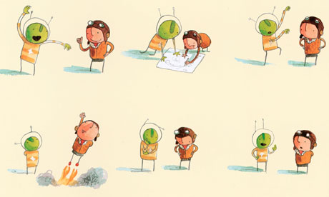
Slide 7 – Illustrations provide character traits and show the relationship between characters

Slide 9
Slide 8 – Illustrations can clarify how a character is feeling

Slide 10
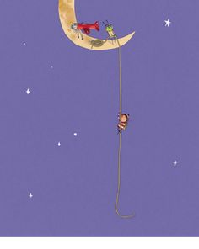
Slide 9 – Illustrations often add to the plot

Slide 11
Slide 10 – Illustrations can give a reader a sense of mood, can add humour, and show motion

